Slide 1


Slide 2
Kelompok 4
M Iqbal Ismail Safei P (1806041)
M Ihsan Riyadhi (1806046)
Ridwan Burhanuddin (1806054)
Rizki Raisha Nurhakim (1806060)
Fauzan Abdurrahman (1806065)
Jaringan NIRKABEL

Slide 3

5G: LTE-Advanced

Slide 4
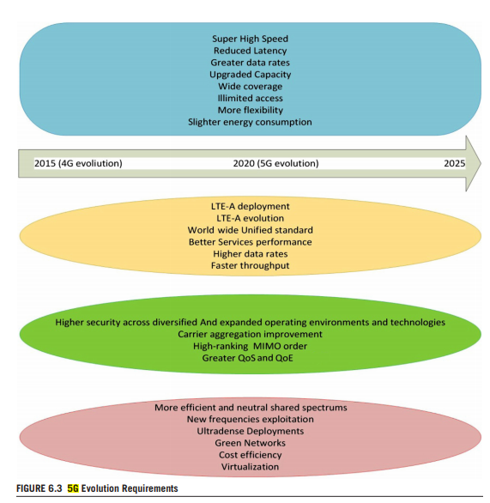

Slide 5
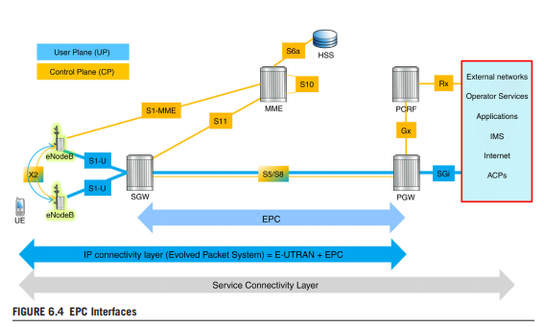

Slide 6
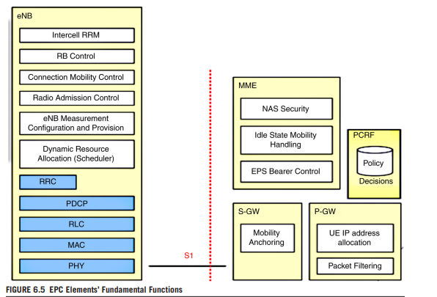

Slide 7
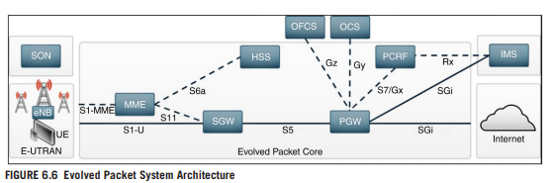

Slide 8
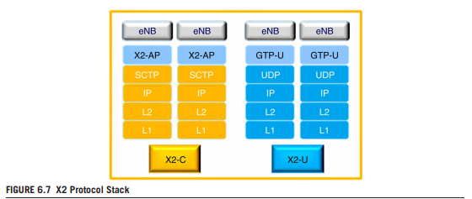

Slide 9
TERIMA KASIH

